Slide 1
UNIT 3
Small Scale Fading
Introduction Small scale multipath propagation, Impulse response model of multipath channel, Impulse response model of multipath channel
Small scale multipath measurements - Direct Pulse measurement, Sliding correlator measurement, Swept frequency measurement, Parameters of mobile multipath channels - Time dispersion and Coherent bandwidth, Parameters of mobile multipath channels - Doppler spread and Coherent time
Types of fading: Flat and Frequency selective fading, Types of fading: Flat and Frequency selective fading, Types of fading: Fast and Slow fading, Ricean distribution, Rayleigh distribution , Solving problems – Doppler effect
Text books, references:
Rappaport T.S, “Wireless Communications: Principles and Practice”, Pearson education

Slide 2
WEEK-1
Introduction Small scale multipath propagation, Solving problems – Doppler effect, Impulse response model of multipath channel, Impulse response model of multipath channel

Slide 3
Small-Scale Fading and Multipath
The term fading is used to describe rapid fluctuation of the amplitude of a radio signal over a short period of time or travel distance.
Fading is caused by destructive interference between two or more versions of the transmitted signal being slightly out of phase due to the different propagation time.
This is also called multipath propagation.
The different components are due to reflection and scattering form trees buildings and hills etc.

Slide 4
Small-Scale Fading and Multipath
At a receiver the radio waves generated by same transmitted signal may come From
Different direction
With Different propagation delays,
With Different amplitudes
With Different phases.
Each of the factor given above is random
The multipath components combine vectorially at the receiver and produce a fade or distortion.

Slide 5
Effects of Fading/Multipath
Multipath propagation creates small-scale fading effects.
The three most important effects are:
Rapid changes in signal strength over a small travel distance or time interval;
Random frequency modulation due to varying Doppler shifts on different multipath signals; and
Time dispersion (echoes) caused by multipath propagation delays.
Even when a mobile receiver is stationary, the received signal may fade due to a non-stationary nature of the channel (reflecting objects can be moving)

Slide 6
Factors influencing small-scale fading
Multipath propagation
The presence of reflecting objects and scatterers in the space between transmitter and receiver creates a constantly changing channel environment
Causes the signal at receiver to fade or distort
Speed of mobile receiver
The relative motion between the transmitter and receiver results in a random frequency modulation due to different Doppler shifts on each of the multipath signals
Doppler shift may be positive or negative depending on direction of movement of mobile

Slide 7
Factors influencing small-scale fading
Speed of surrounding objects:
If the speed of surrounding objects is greater than mobile, the fading is dominated by those objects
If the surrounding objects are slower than the mobile, then their effect can be ignored
The transmission bandwidth:
Depending on the relation between the signal bandwidth and the coherence bandwidth of the channel, the signal is either distorted or faded
If the signal bandwidth is greater than coherence bandwidth it creates distortion
If the signal bandwidth is smaller than coherence bandwidth it create small scale fading
The coherence bandwidth of a wireless channel is the range of frequencies that are allowed to pass through the channel without distortion. This is the bandwidth over which the channel transfer function remains virtually constant.

Slide 8
Some Terminologies
Level Crossing Rate
Average number of times per sec that the signal crosses a certain level going in positive going direction
Fading Rate
Number of times the signal envelop crosses middle value in positive going direction per unit time
Depth of Fading
Ratio of mean square value and minimum value of fading
Fading Duration
Time for which signal remain below a certain threshold

Slide 9
Doppler shift
Change in the apparent frequency of a signal as Tx and Rx move toward or away from each other
If mobile is moving towards the direction of arrival of the signal, the Doppler shift is positive(apparent received frequency is increased i.e. fc+fd) and vice versa.

Slide 10
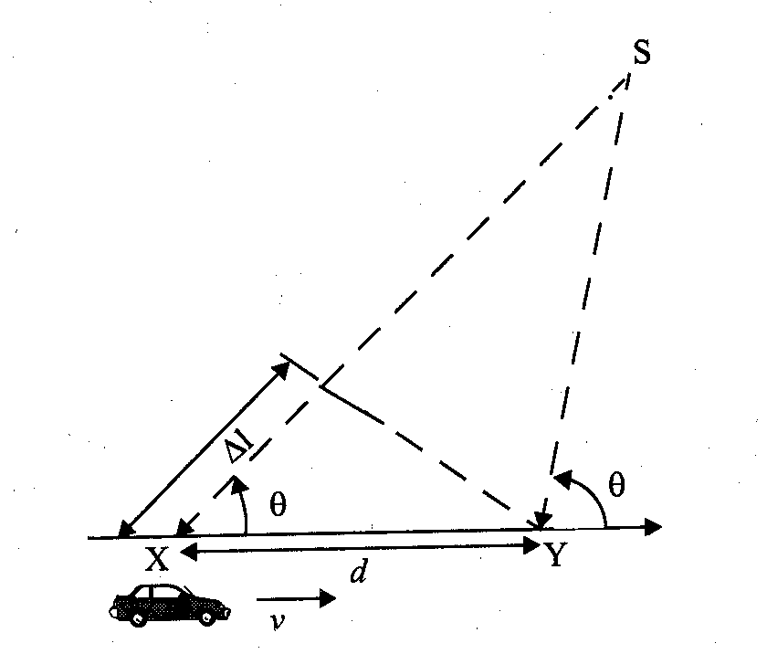
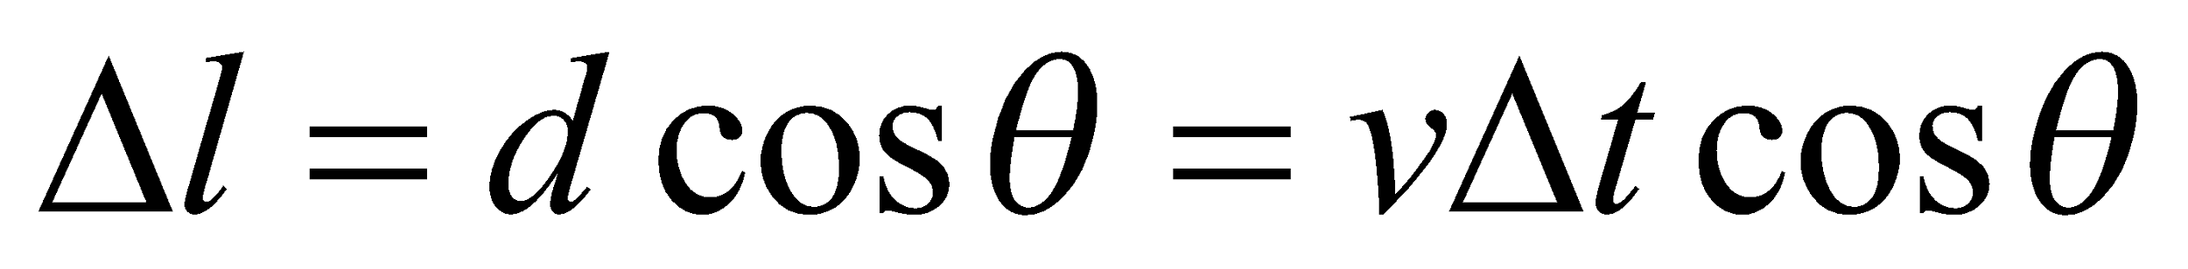
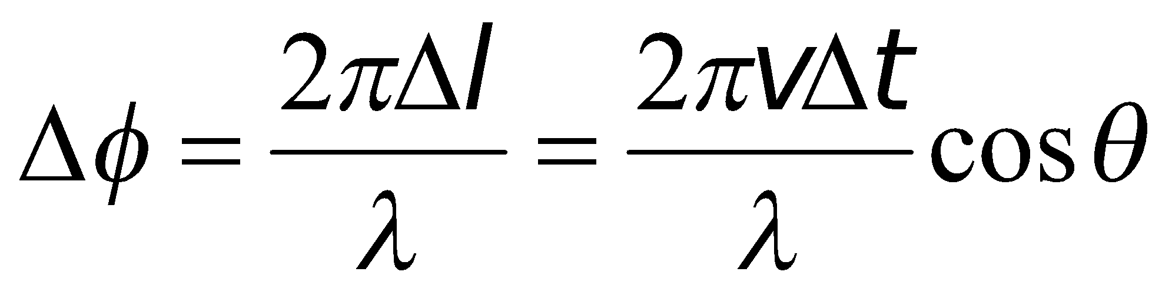
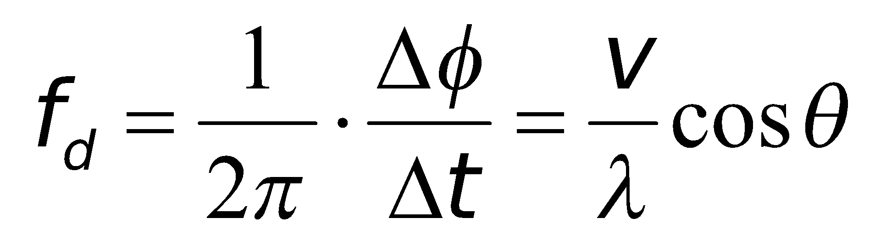
Small-Scale Multipath Propagation
Doppler Shift
A mobile moves at a constant velocity v, along a path segment having length d between points X and Y.
Path length difference
Phase change
Doppler shift

Slide 11
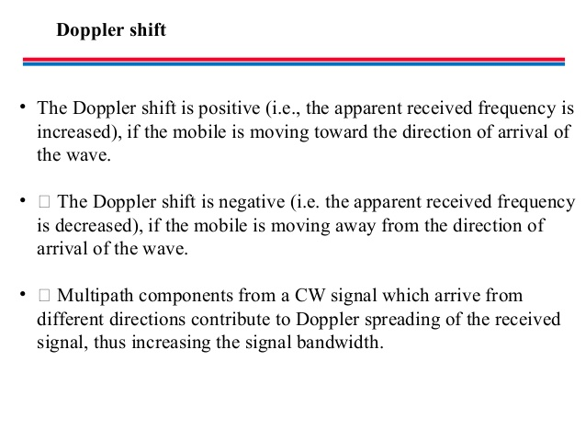

Slide 12
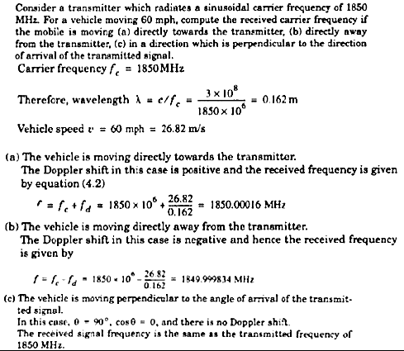

Slide 13
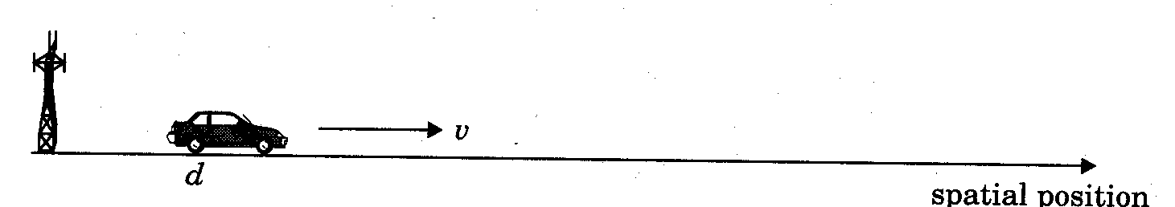
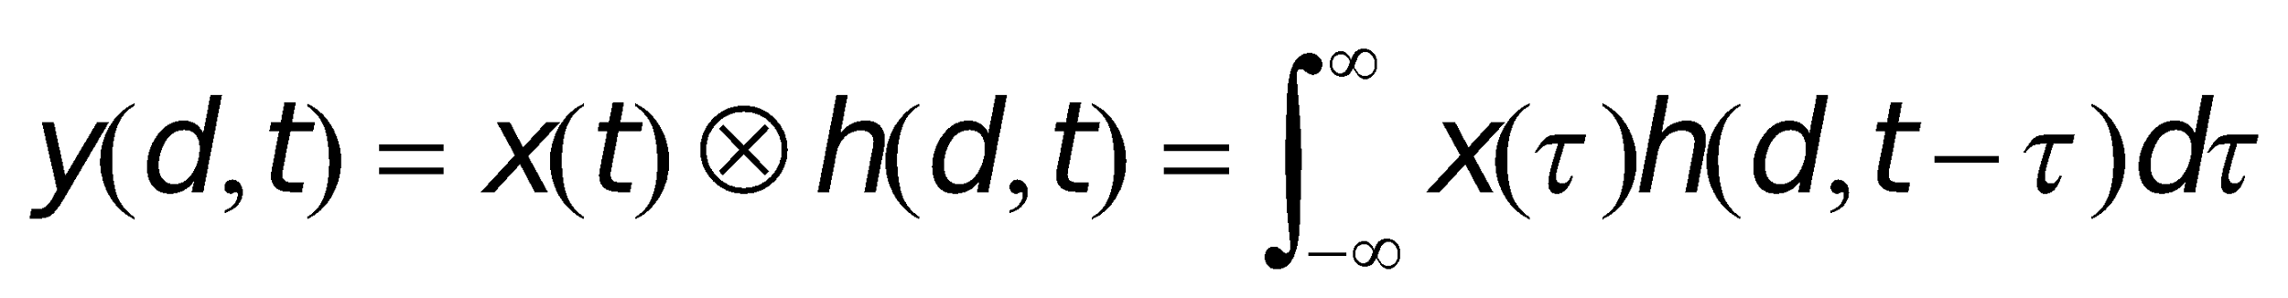
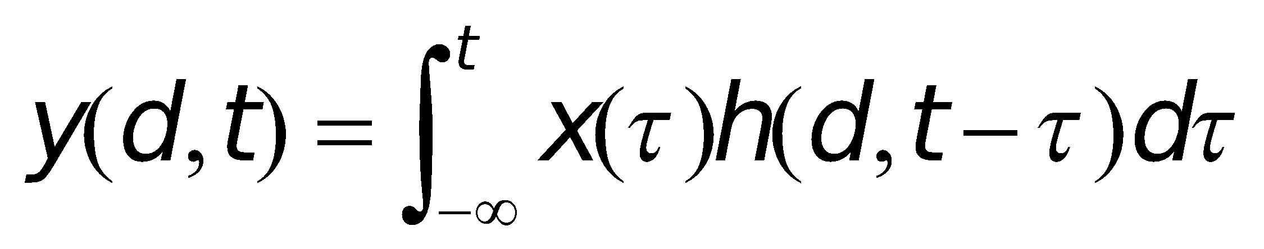
Impulse Response Model of a Multipath Channel
A mobile radio channel may be modeled as a linear filter with a time varying impulse response
time variation is due to receiver motion in space
filtering is due to multipath
The channel impulse response can be expressed as h(d,t). Let x(t) represent the transmitted signal, then the received signal y(d,t) at position d can be expressed as
For a causal system

Slide 14
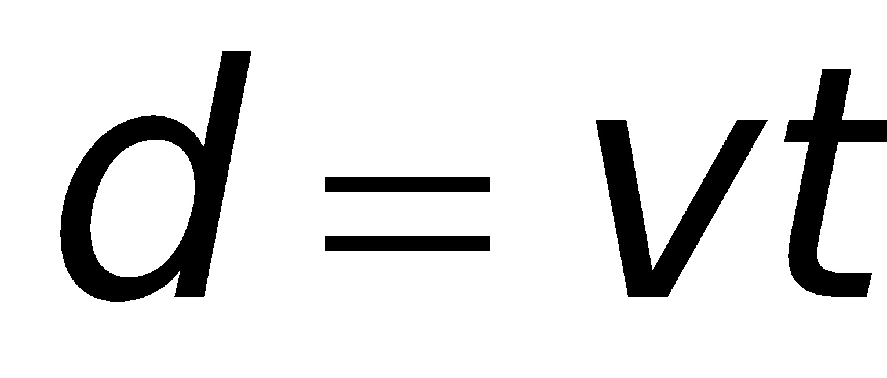
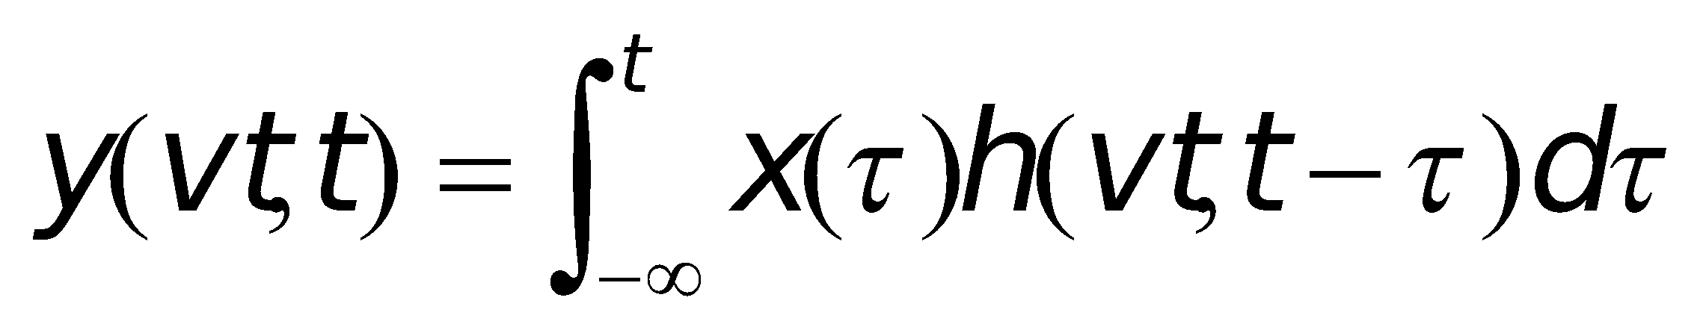
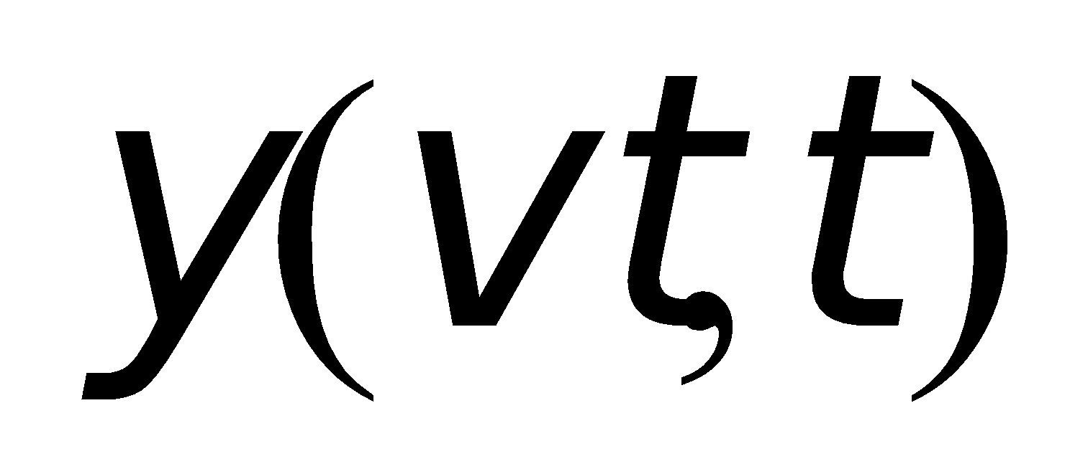
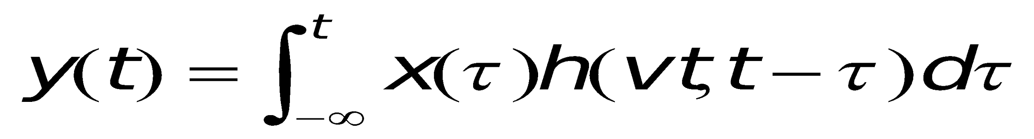
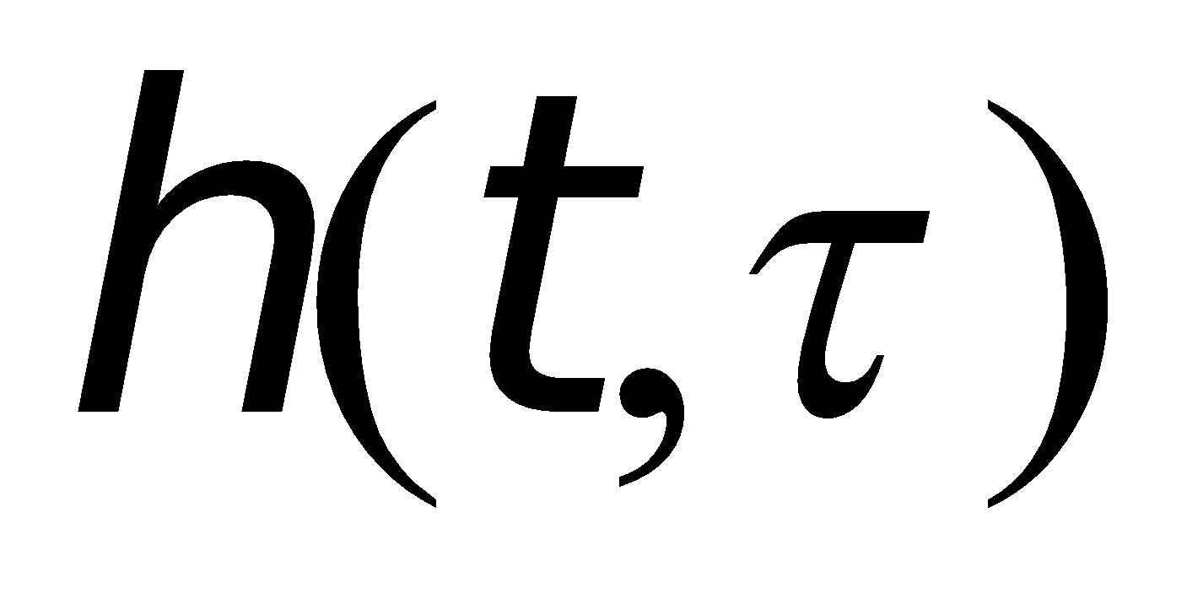

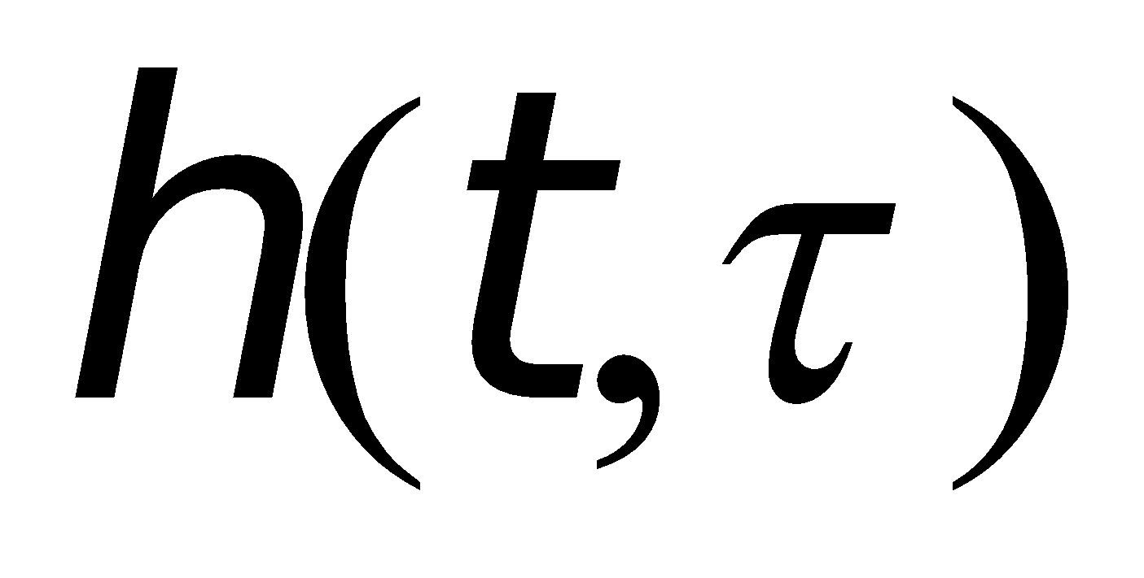
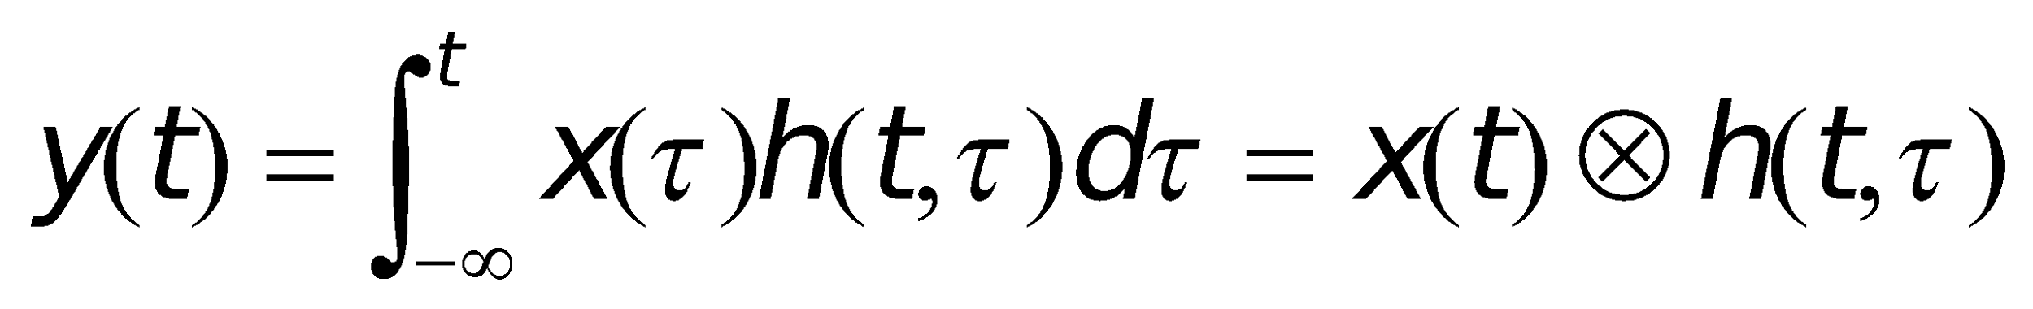
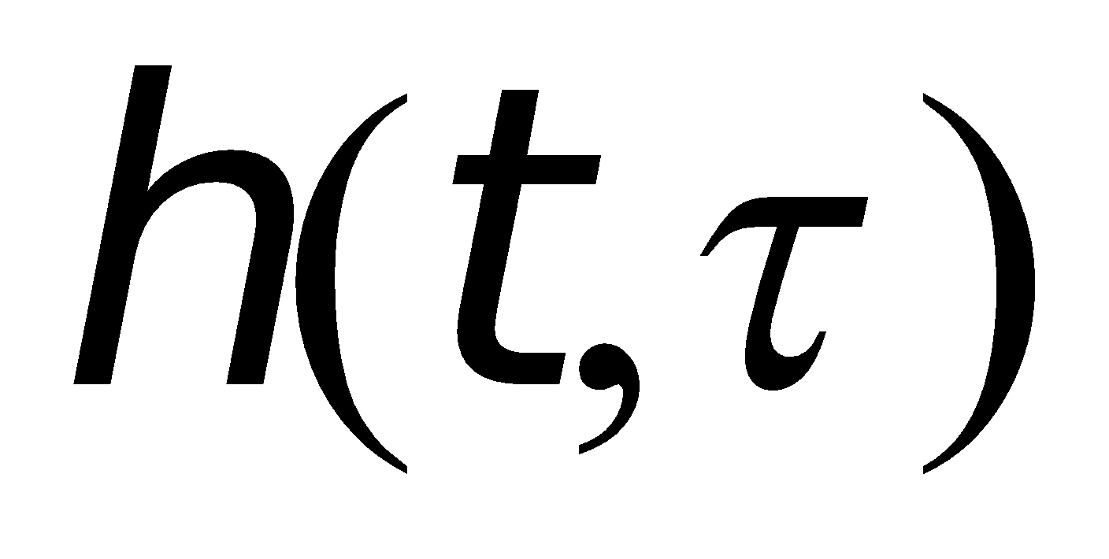
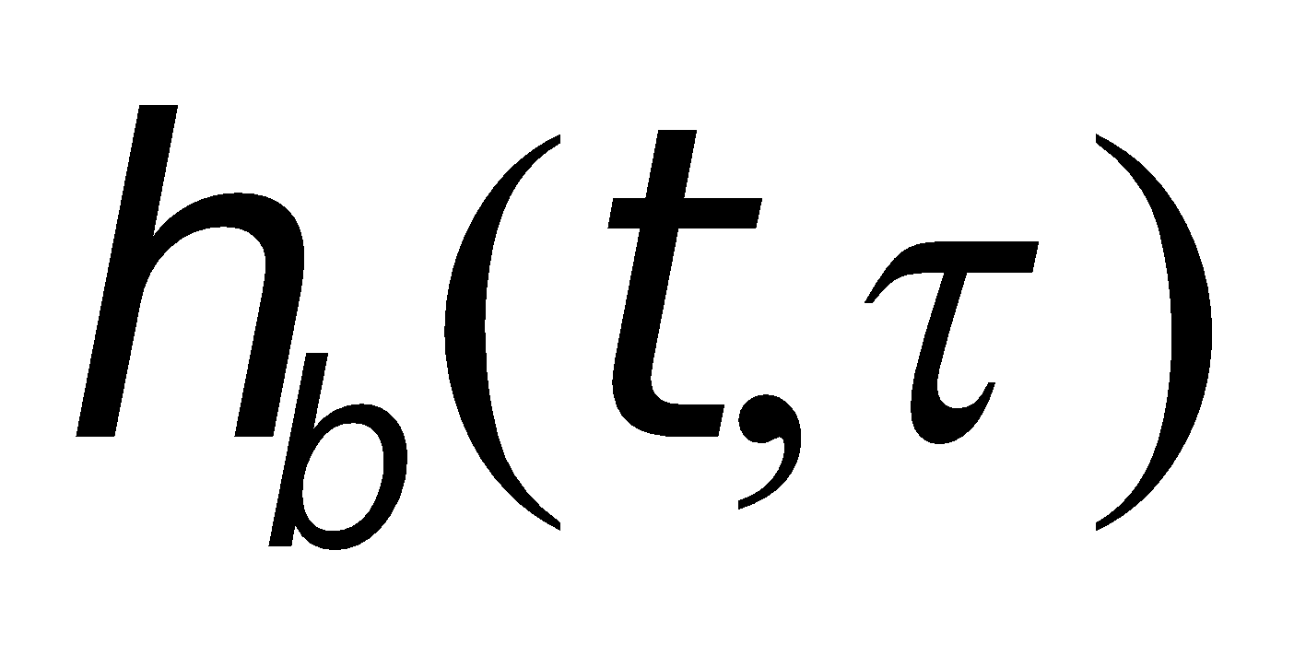
Impulse Response Model of a Multipath Channel
The position of the receiver can be expressed as
We have
Since v is a constant, is just a function of t.
In general, the channel impulse response can be expressed
t : time variation due to motion
: channel multipath delay for a fixed value of t.
With the channel impulse response , we may have the output
For bandlimited bandpass channel, then may be equivalently described by a complex baseband impulse response
The equivalent baseband output

Slide 15
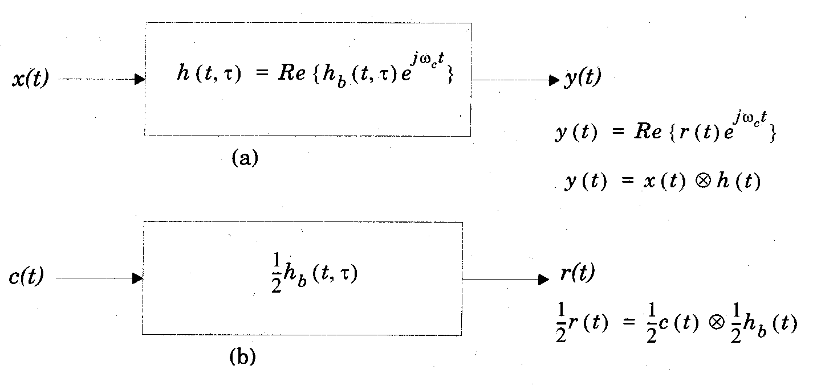
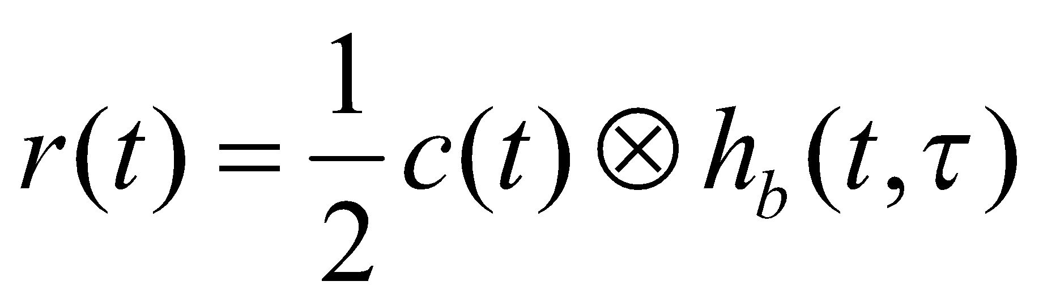
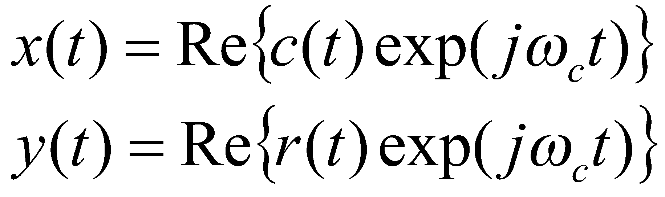
Impulse Response Model of a Multipath Channel

Slide 16
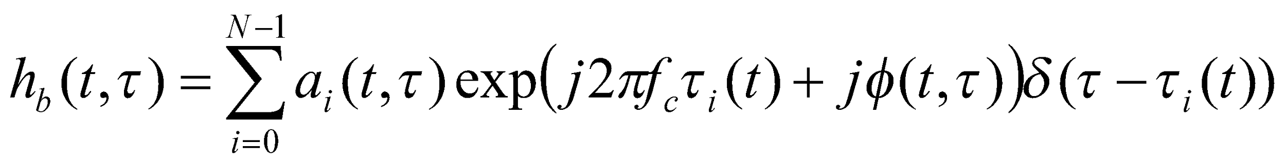
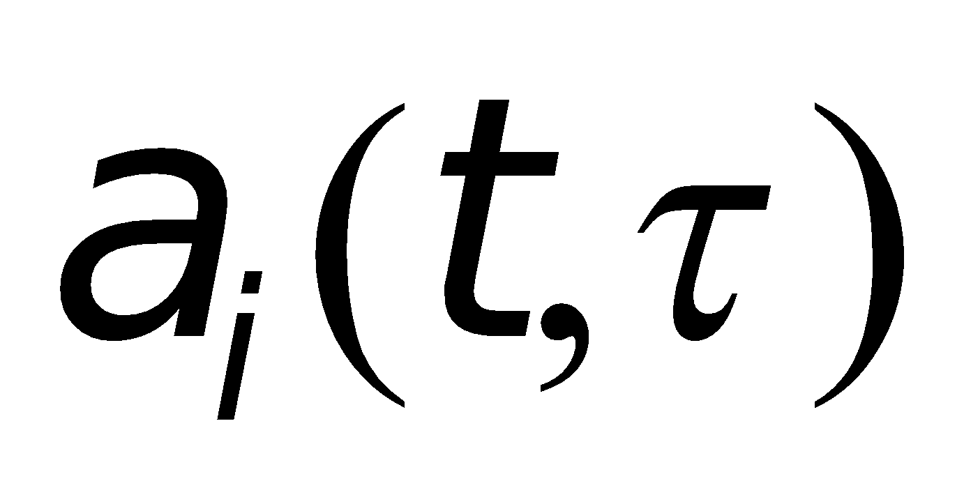
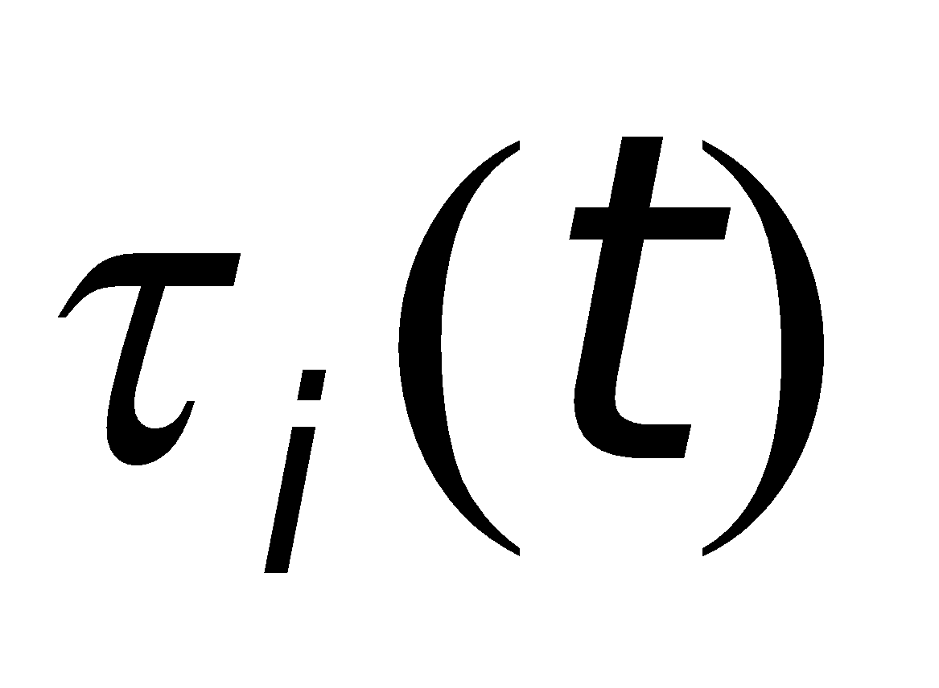
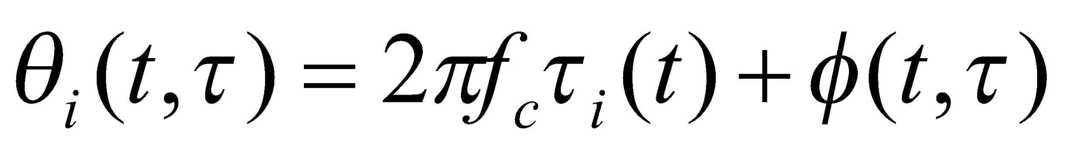
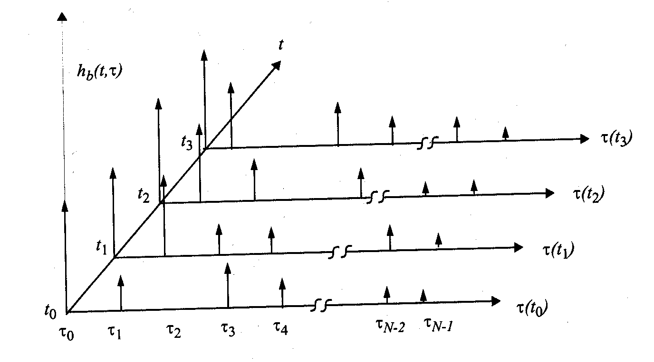
Impulse Response Model of a Multipath Channel
Discretize the multipath delay axis into equal time delay segments called excess delay bins.
The baseband response of a multipath channel can be expressed as
: amplitude of the ith multipath component
: excess delay of ith multipath component
Define

Slide 17
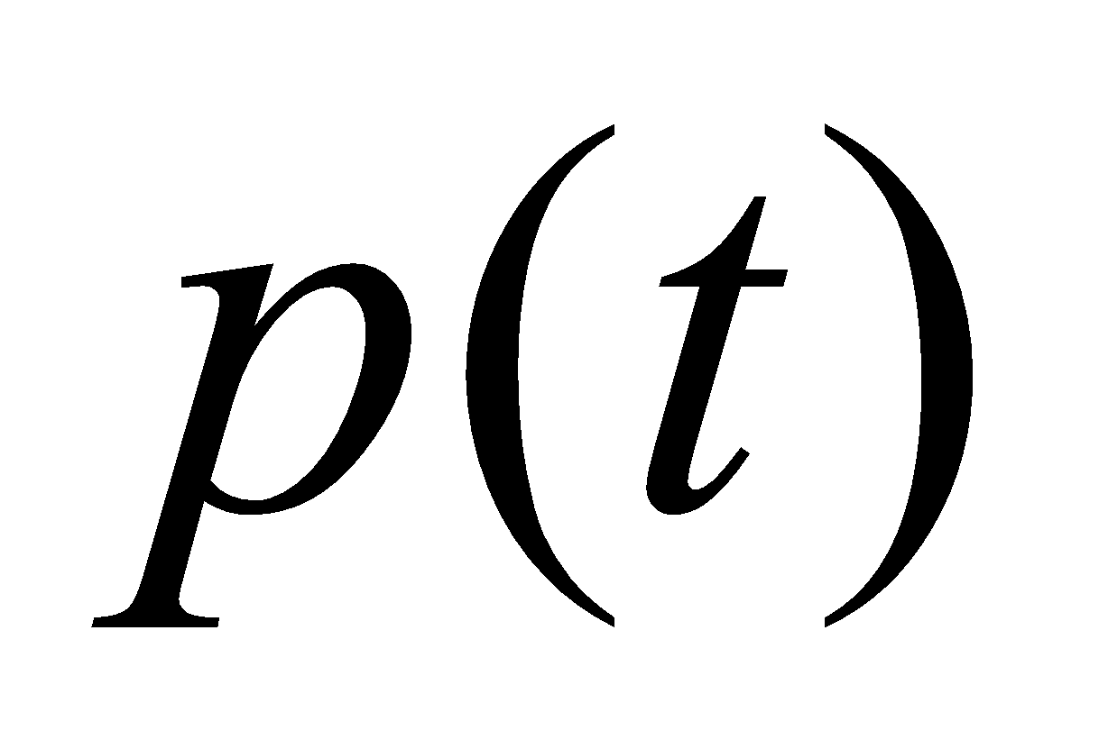
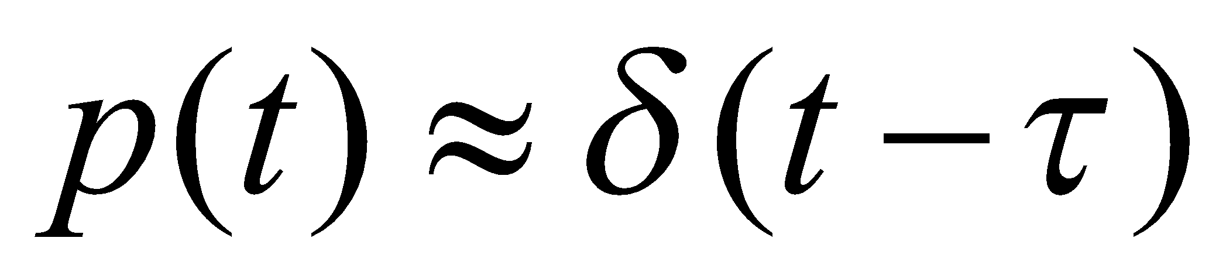
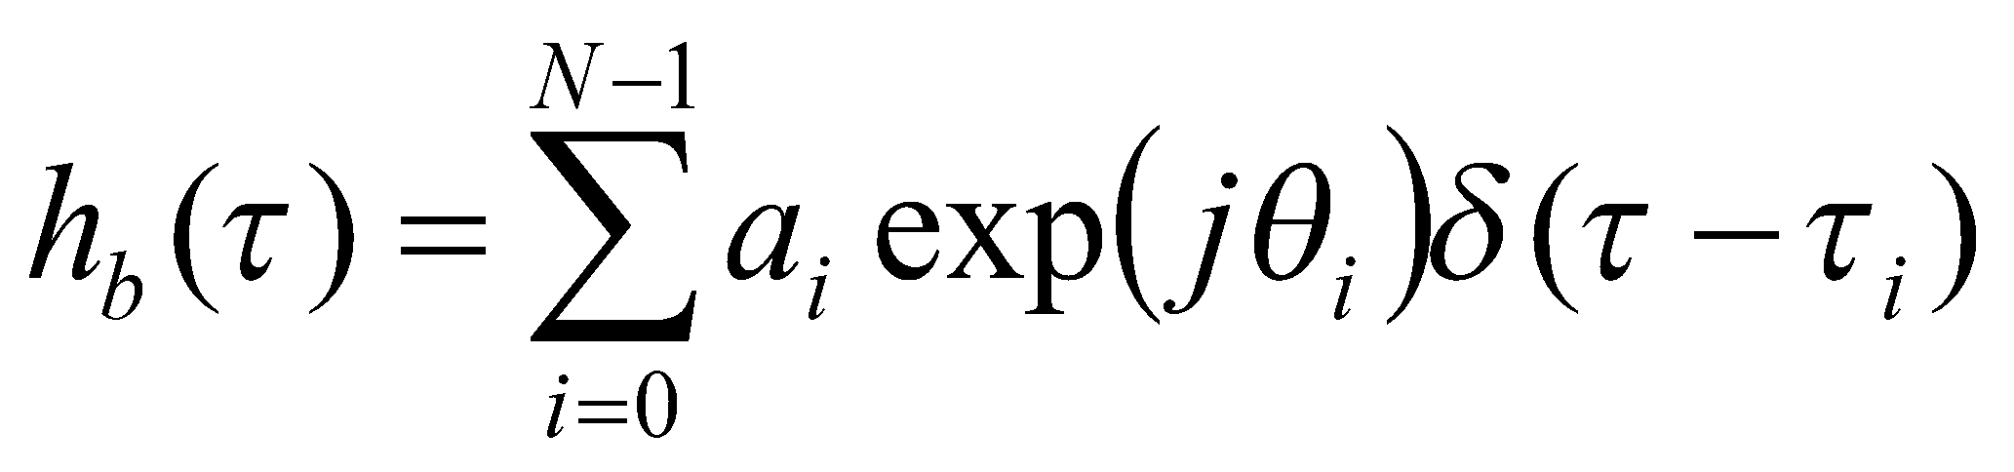
Impulse Response Model of a Multipath Channel
If the channel impulse response is assumed to be time invariant, the channel impulse response may be simplified as
The impulse response may be measured by using a probing pulse which approximates a delta function.

Slide 18

Power Delay Profile
For small scale fading, the power delay profile of channel can be found using the spatial average of over the local area.
It P(t) has time duration much smaller than the impulse response of multipath channel, the received power delay profile in local area can be
Where the gain k relates the power of input pulse to the received power.

Slide 19
Measuring PDPs
Power Delay Profile
Are measured by channel sounding techniques
Plots of relative received power as a function of excess delay
They are found by averaging instantaneous power delay measurements over a local area
Local area: no greater than 6m outdoor
Local area: no greater than 2m indoor
Samples taken at /4 meters approximately
For 450MHz – 6 GHz frequency range.

Slide 20
Review questions
What are the most important characteristics of wireless channel ?
Path loss
Fading
Interference
Doppler shift

Slide 21
Review questions
What is Fading?
In Wireless Communication, fading refers to the attenuation of the transmitted signal power due to various variables during wireless propagation. These variables can be atmospheric conditions such as rainfall and lightning, geographical position, time, radio frequency etc.

Slide 22
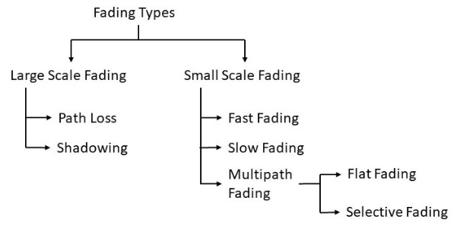
Review questions
What are the different types of fading?

Slide 23
Review questions
Do Fading channel has memory. a) True b) False
Yes, Fading channel has memory and the received samples are correlated with each other in time.

Slide 24
Review questions
Mention the two main forms of interference in Wireless transmissions.
Adjacent channel interference and
Co-channel interference.

